Slide 1

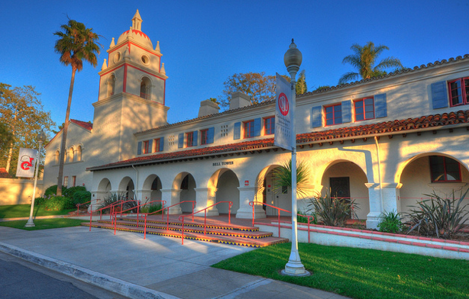
Startup Marketing and Growth Hacking
Big Data Marketing
Minder Chen, Ph.D.
Professor of MIS
Martin V. Smith School of Business & Economics
CSU Channel Islands
minder.chen@csuci.edu

Slide 2
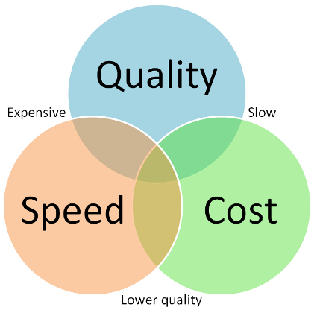
商業模式九宮格
關鍵夥伴KP: Key Partners
關鍵活動KA: Key Activities
價值主張VP: Value Proposition
顧客關係
CR: Customer
Relationships
-招來新顧客
-留住老顧客
-增漲顧客購買
顧客群
CS: Customer Segments
-行銷
-研發
-製造/服務作業
產品和服務
-功能性(Functional)
-社交性(Social)
-情緒性(Emotional)
-活動外包商
-產品供應商
-資源供應商
-待完成的工作
-顧客旅程圖
-人物誌Persona
-痛點/快樂
-潛在需求
-消費者/企業
-巿場大TAM/SAM/TM
關鍵資源KR: Key Resources
銷售渠道
CH: Channels
-實體通路
-虛擬通路
-由虛至實O2O
-人才
-技術
-創新文化
成本結構 C$: Costs Structures
營收來源 R$: Revenue Streams
-新顧客獲取成本
-技術/產品取、開發成本
-盈收模式 - 毛利率 -註冊人數 -口碑WOM
-訂價策略/Freemium -活躍的使用者人數
-顧客終生價值(CLTV) -同期顧客 留失/保留率
Notes:
http://www.taiwan-innovation.org.tw/manage/admin/tiny_upload/BMI_1.pdf
http://www.wizxpand.com/what-is-persona/

Slide 3







BMC Template
What Key Activities do we require?
Manufacturing? Software? Supply chain?
Which of our customer’s problems are we helping to solve?
Which customer needs are we satisfying
What are the Key Features of our product that match customers problem/need?
How will we Get, Keep and Grow Customers?
Who are our Key Partners?
Who are our key suppliers?
What are we getting from them? Giving them?
Who are our most important customers?
What are their archetypes?
What Job do they want us to get done for them?
What Key Resources we require?
Financial, physical, IP, HR?
Through which Channels do our Customer Segments
want to be reached?
What are the most important costs inherent in our business model?
Fixed? Variable?
How do we make money? What’s the revenue model? Pricing tactics?

Slide 4
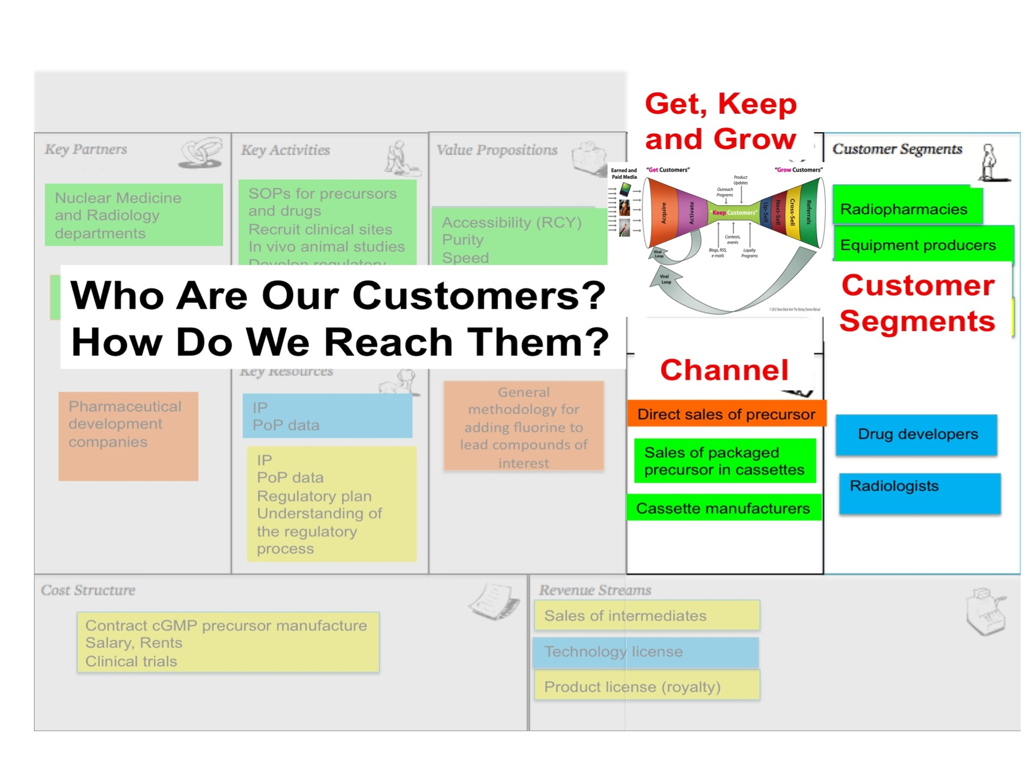
Pick the customer segments based on your value proposition & pricing tactics then find the right way to get, keep and grow your targeted customers driven by your business model.

Slide 5
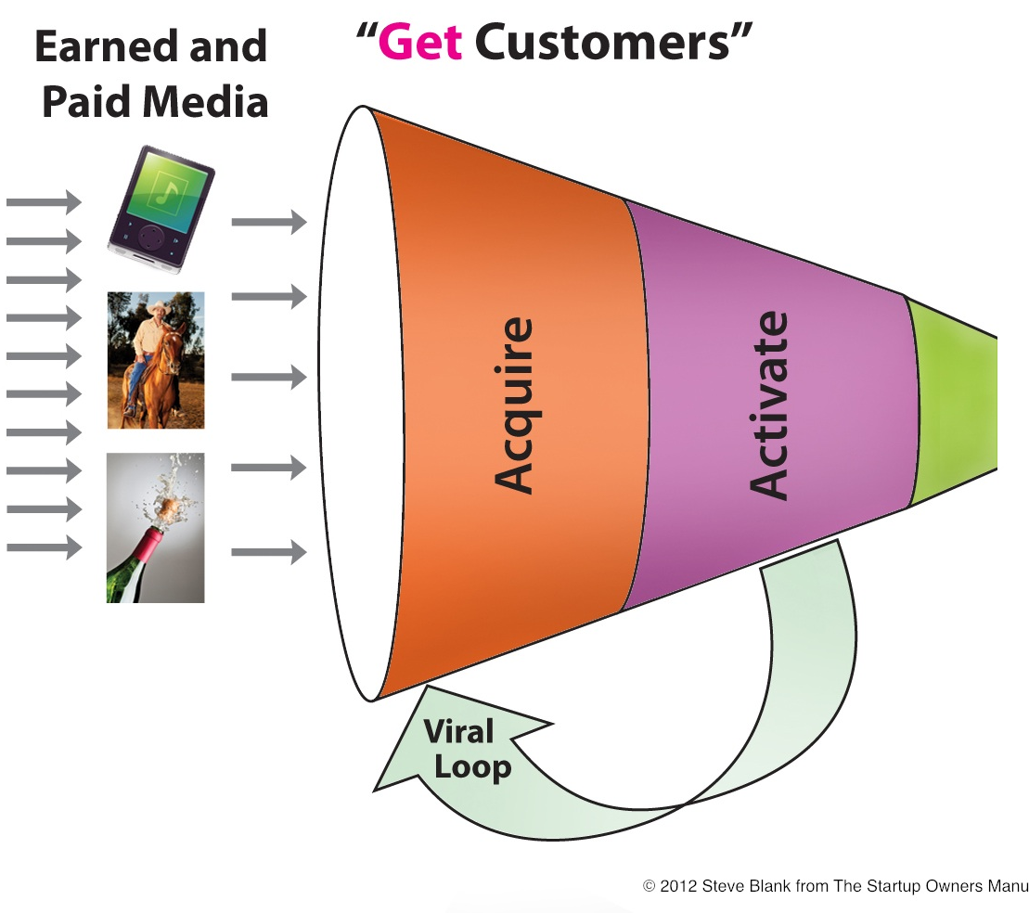
Customer Development = The pursuit of customer understanding
Marketing
Habit 5: Seek First To Understand, Then To Be Understood.
-- “The 7 Habits of Highly Effective People”,

Slide 6
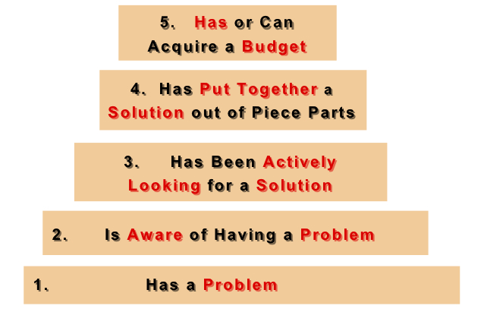
Earlyvangelists = Early Adopter + Internal Evangelist
They have a problem.
They understand they have a problem.
They are actively searching for a solution and has a timetable for finding it.
The problem is painful enough that they have cobbled together an interim solution.
They have, or can quickly acquire, dollars to purchase the product to solve their problem.
Steve Blank Perfection By Subtraction – The Minimum Feature Set

Slide 7
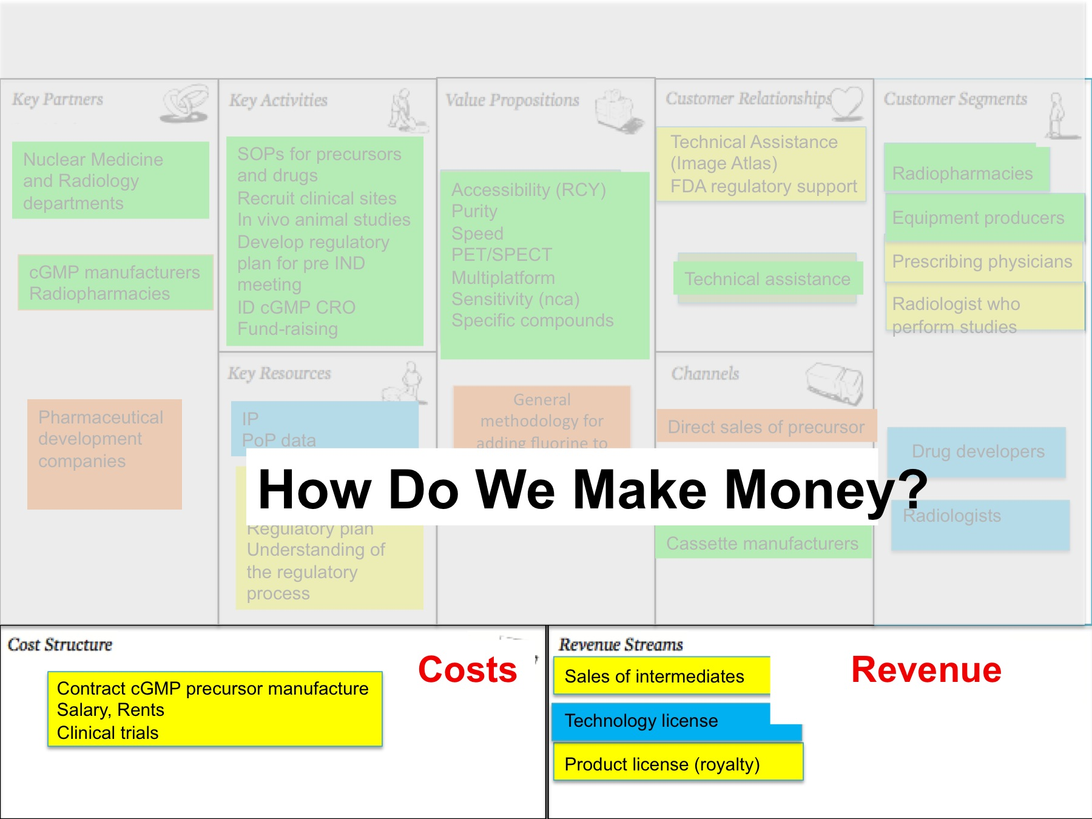

Slide 8
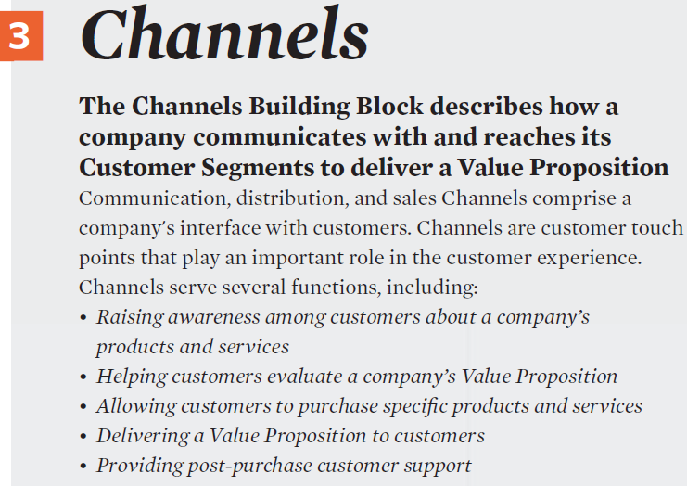
Facilitate
Customer’s
Procurement Process

Slide 9
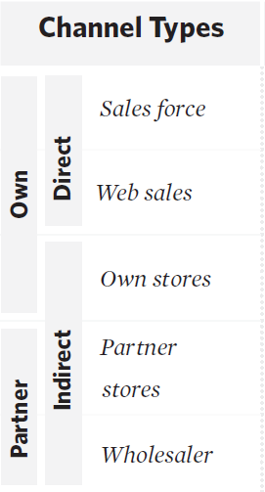
Chanel Classifcation

Slide 10
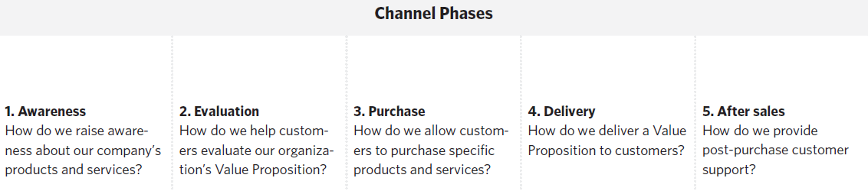
Marketing/Sales Funnel

Slide 11
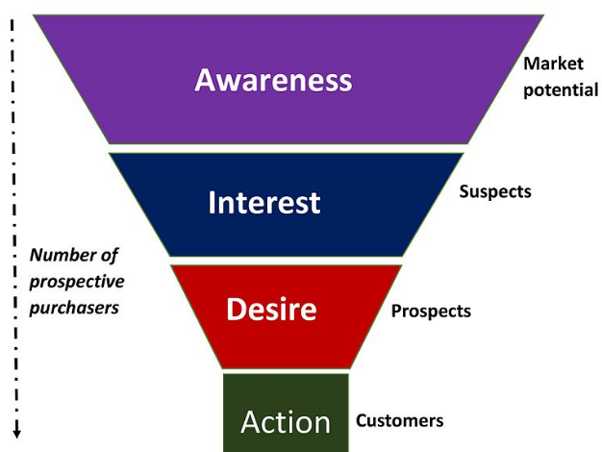
AIDA: The Purchase Funnel
The consumer becomes aware of a category, product or brand (usually through advertising)
The consumer becomes interested by learning about brand benefits & how the brand fits with lifestyle
The consumer develops a favorable disposition towards the brand
The consumer forms a purchase intention, shops around, engages in trial or makes a purchase
AISDALSLove model:
Awareness→ Interest→ Search →Desire→
Action → Like/dislike → Share → Love/ Hate
https://en.wikipedia.org/wiki/AIDA_(marketing)

Slide 12
Marketing is…
At the core, marketing is lead generation.
Ads drive awareness…to drive sales.
PR and publicity drive attention…to drive sales.
Social media drives communication…to drive sales.
Marketing is not an end unto itself. It is simply getting customers. And by the transitive property, anything that gets customers is marketing.
http://www.fastcompany.com/3003888/everything-marketing-how-growth-hackers-redefine-game

Slide 13
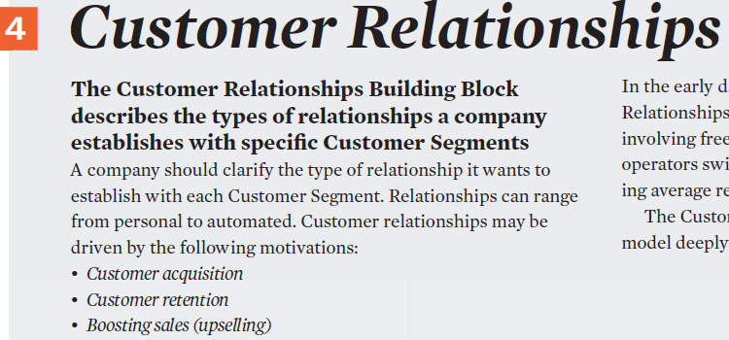


Slide 14
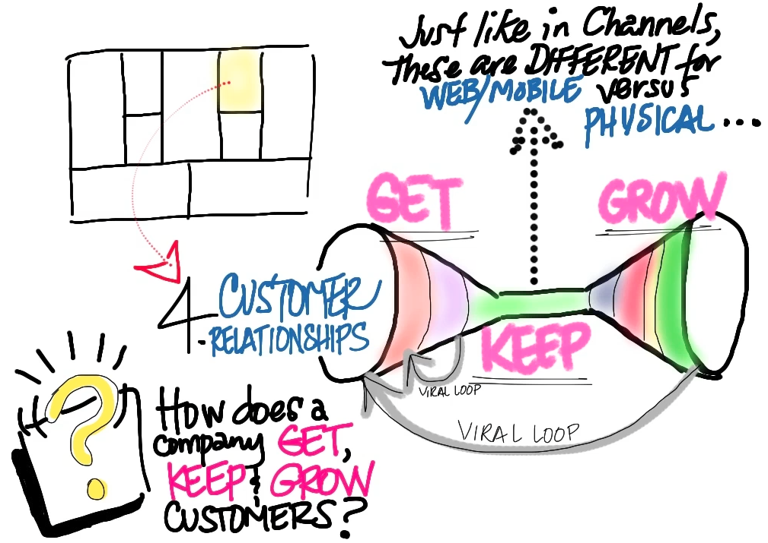
Customer Relationship
CS: Who are our customers?
CH: How do we reach customer?
CR: How will we get, keep, and grow customers?

Slide 15
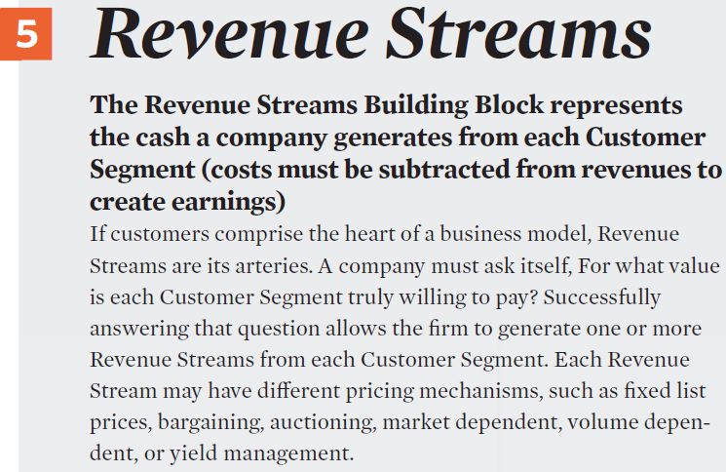
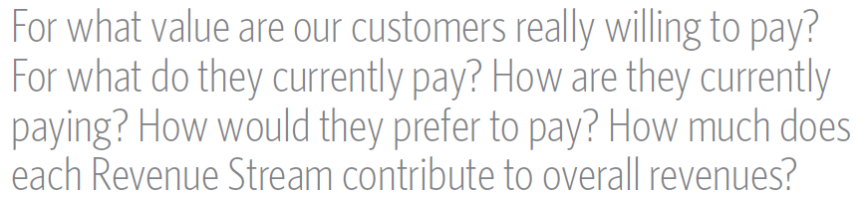

Slide 16
Revenue Streams
Asset (product) sale: Transaction
Usage fee
Subscription fees
Lending/Renting/Leasing
Licensing
Brokerage fees
Advertising
Two different types of Revenue Streams:
Transaction revenues resulting from one-time customer payments
Recurring revenues resulting from ongoing payments to either deliver a Value Proposition to customers or provide post-purchase customer support
Pricing mechanism: fixed and dynamic pricing.

Slide 17
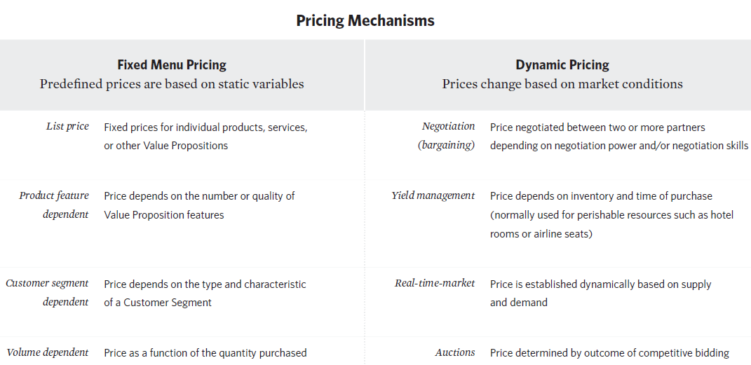
xxxxxx

Slide 18
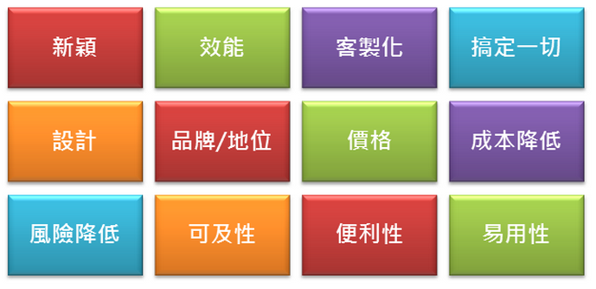
Value Proposition
New
Effective
Customized
All-in-one
Better Design
Brand/Positioning
Price
Lower cost
Lower risk
Accessible
Convenience
Easy to use
Notes:
http://5grow.com/archives/603

Slide 19

Value Proposition: Product Attributes and Levels
12 Business Decisions you can Optimize with Conjoint Analysis | eBook | Qualtrics

Slide 20
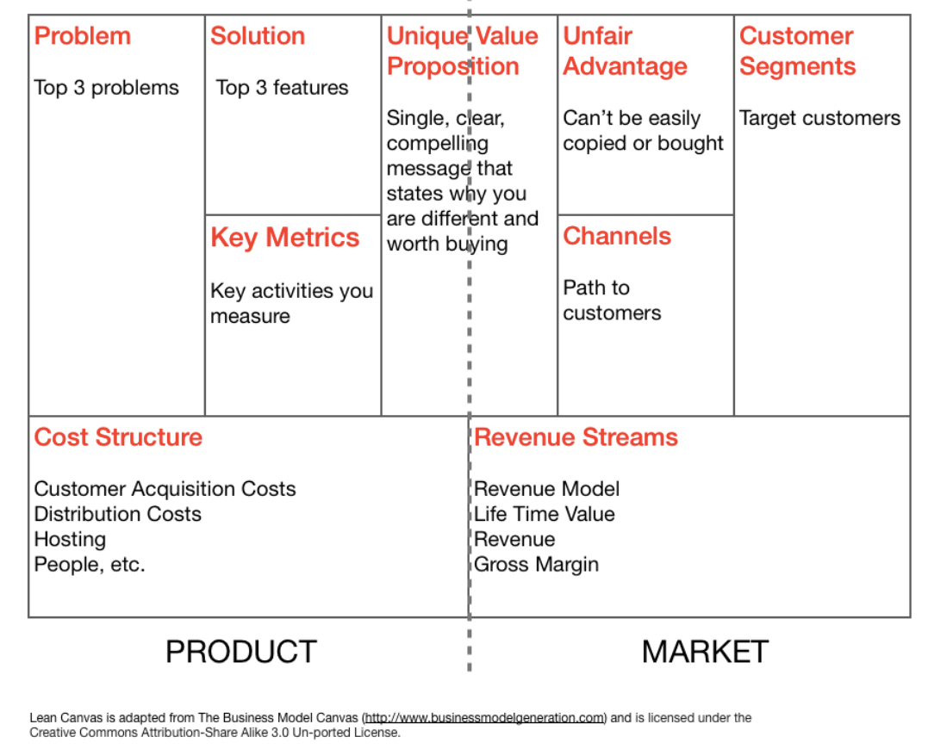
Lean Canvas and Marketing Analytics
An Introduction to Lean Canvas. As an entrepreneur, one of the most… | by Steve Mullen | Medium
Profit

Slide 21
BMC vs Book Chapters
關鍵夥伴 | 關鍵活動 Ch 7 | 價值主張 Ch 4 Ch 6 |  | 顧客關係 Ch 8 | 顧客群體 Ch 2 Ch 3 Ch 5
 | 關鍵資源 Ch 7 |  |  | 顧客渠道 Ch 3 Ch 7
成本結構 Ch 6 |  |  | 營收來源 Ch 2; Ch5
Ch1 - The ME approach
Ch2 - Customer value
Ch3 - Segmentation & targeting
Ch4 – Positioning
Ch5 - Forecasting
Ch6 - New product design
Ch7 - Marketing mix
Ch8 - Digital marketing
Ch9 - Harvesting value from ME

Slide 22
Growth hacking: Definition
Growth hacking is about exploiting information or users to generate impressive gains in traffic, revenue, or users.
A growth hacking is typically:
  Very limited in scope
  Very small improvement
  A very specific idea/feature/design ➔ use A/B test, Call to Actions (CTA)
https://dprol.files.wordpress.com/2014/06/growth-hacker-marketing-ryan-holiday.pdf

Slide 23
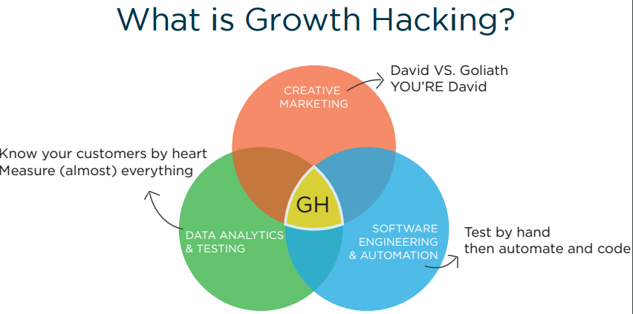
**** Growth is repeatable. With the right framework you can replicate the growth patterns of highly successful companies. Source: http://www.slideshare.net/DavidArnoux1/growth-hacking-guide-mindset-framework-and-tools
The Definitive Guide to Growth Hack - Book (pdf)
Enthusiastic Jonah Berger speaks on Creating Popular Ideas, Viral Videos, & Word-of-Mouth Marketing (video)

Slide 24
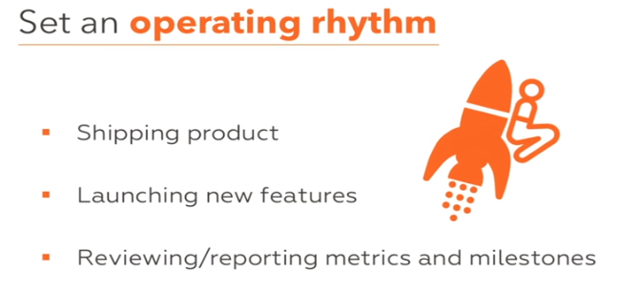
http://startupclass.samaltman.com/ Lecture #1

Slide 25
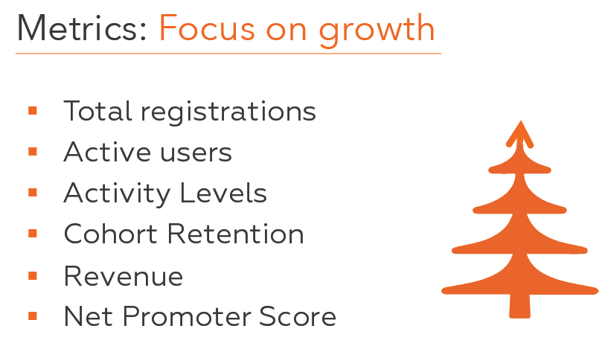
http://startupclass.samaltman.com/ Lecture #1

Slide 26
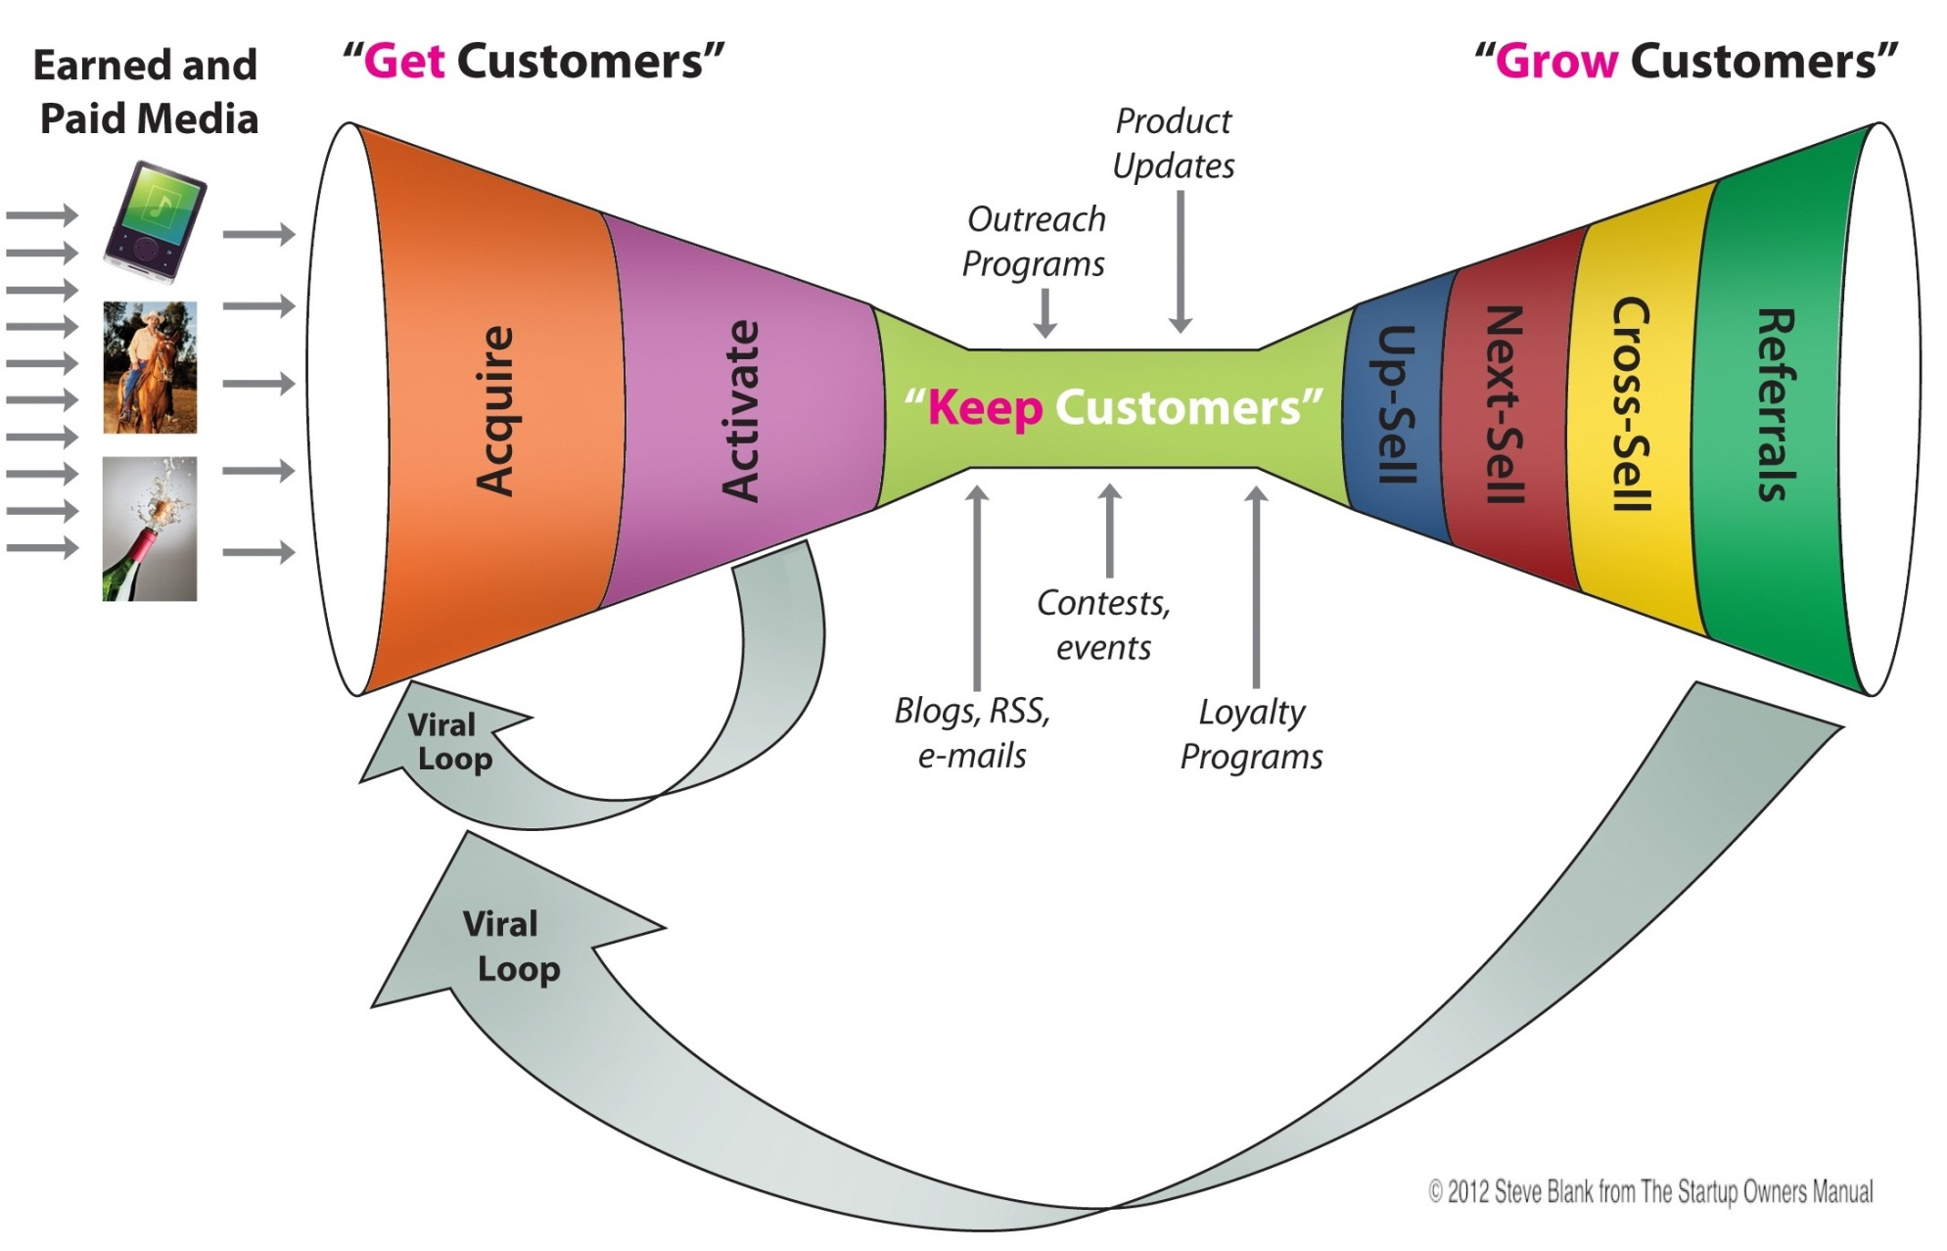
Customer Relationship (Web/Mobile)
http://www.demacmedia.com/wp-content/uploads/2012/11/full-mobile-color-copyright.jpeg

Slide 27
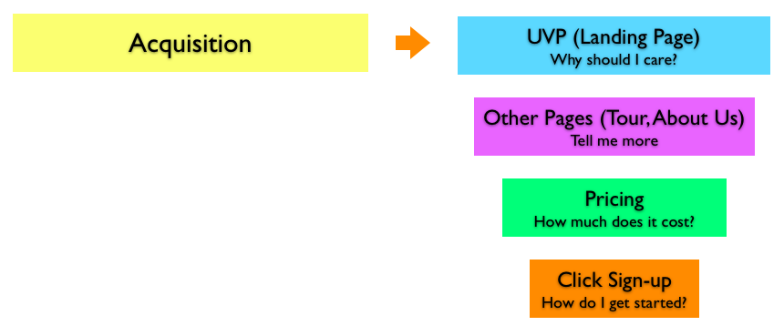
Customer Acquisition ➔ Website
unique value proposition (UVP)
Your landing page should have your UVP front and center.
https://klientboost.com/landing-pages/landing-page-value-proposition/

Slide 28
Customer Acquisition Strategy
Viral marketing
  product design
  word of mouth (viral marketing)
  pricing
Active marketing/outreach
  Advertising
  PR (broadly defined)
  Direct outreach
Distribution partnerships
Design optimization
http://giffconstable.com/2009/12/what-is-your-customer-acquisition-strategy-startup-marketing-tactics/

Slide 29
Growth Rate Matters
A startup is a company designed to grow fast. Being newly founded does not in itself make a company a startup. Nor is it necessary for a startup to work on technology, or take venture funding, or have some sort of "exit." The only essential thing is growth. Everything else we associate with startups follows from growth.
weekly | yearly
1% | 1.7x
2% | 2.8x
5% | 12.6x
7% | 33.7x
10% | 142.0x
=POWER((1+10%), 52)
A company that grows at 1% a week will grow 1.7x a year, whereas a company that grows at 5% a week will grow 12.6x. A company making $1000 a month (a typical number early in YC) and growing at 1% a week will 4 years later be making $7900 a month, which is less than a good programmer makes in salary in Silicon Valley. A startup that grows at 5% a week will in 4 years be making $25 million a month.
http://www.paulgraham.com/growth.html

Slide 30
Why Growth “Hacking”?
Startups tend to have limited resources, so they need to be creative to acquire new users, retain them, and grow the sales to them.
Traditional marketing channels are expensive and saturated. ➔ Use Internet marketing creatively.
Most startups focus heavily on product but another real challenge is with distribution ➔ Channel & Customer Relationship in the Business Model Canvas (Dave McClure)
Growth Hackers don’t really care about “brand awareness” they care about ROI - finding out “what works”
➔ Driven by metrics ➔ Validated learning
http://www.slideshare.net/DavidArnoux1/growth-hacking-guide-mindset-framework-and-tools

Slide 31
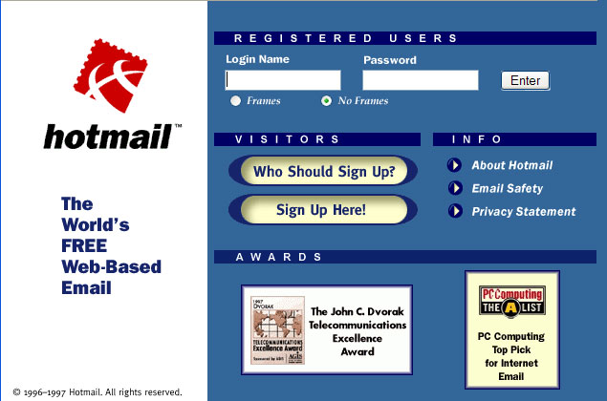
Hotmail’s In-Product Promotion
Hotmail added a tagline, “Get Your Free Email at Hotmail,” at the end of each existing user’s outgoing mail with a link back to their site. They essentially turned their users into advertisers. Within seven months, they had over two million users. Thirty months and they were at 30 million users.
http://thenextweb.com/entrepreneur/2014/05/28/9-iconic-growth-hacks-tech-companies-used-pump-user-base/#gref

Slide 32
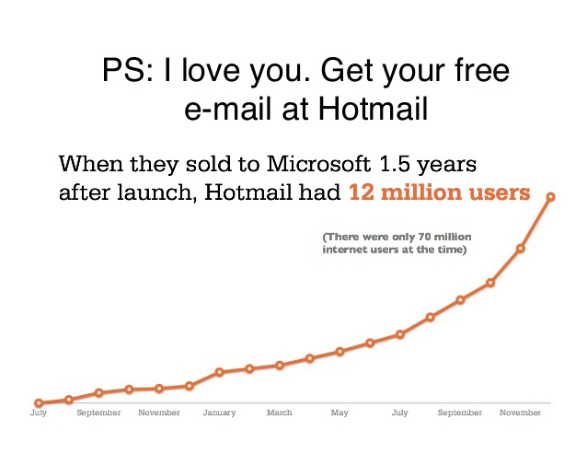
Growth
http://jleclainche.com/a-smart-introduction-to-growth-hacking/

Slide 33
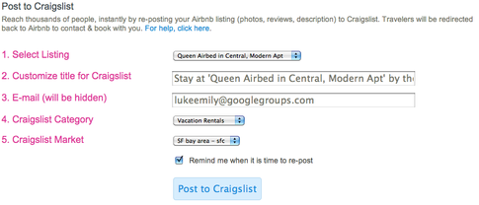
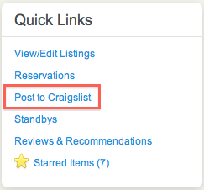
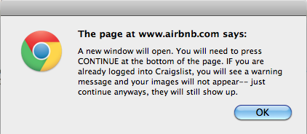
Airbnb’s Craigslist Cross-Posting
How does Airbnb automatically post on Craigslist?
On Airbnb's site, you can automatically post to sublets & temporary or vacation rentals. How does it do this?
http://andrewchen.co/how-to-be-a-growth-hacker-an-airbnbcraigslist-case-study/

Slide 34
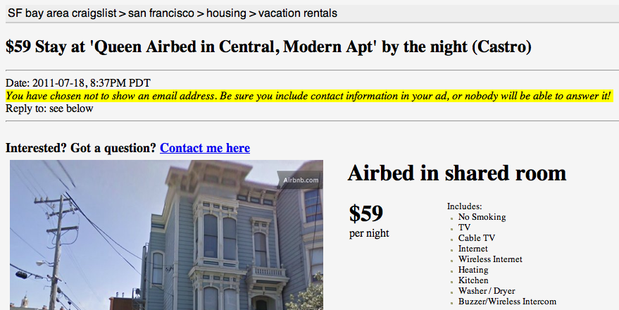
Post It to Craigslist

Slide 35
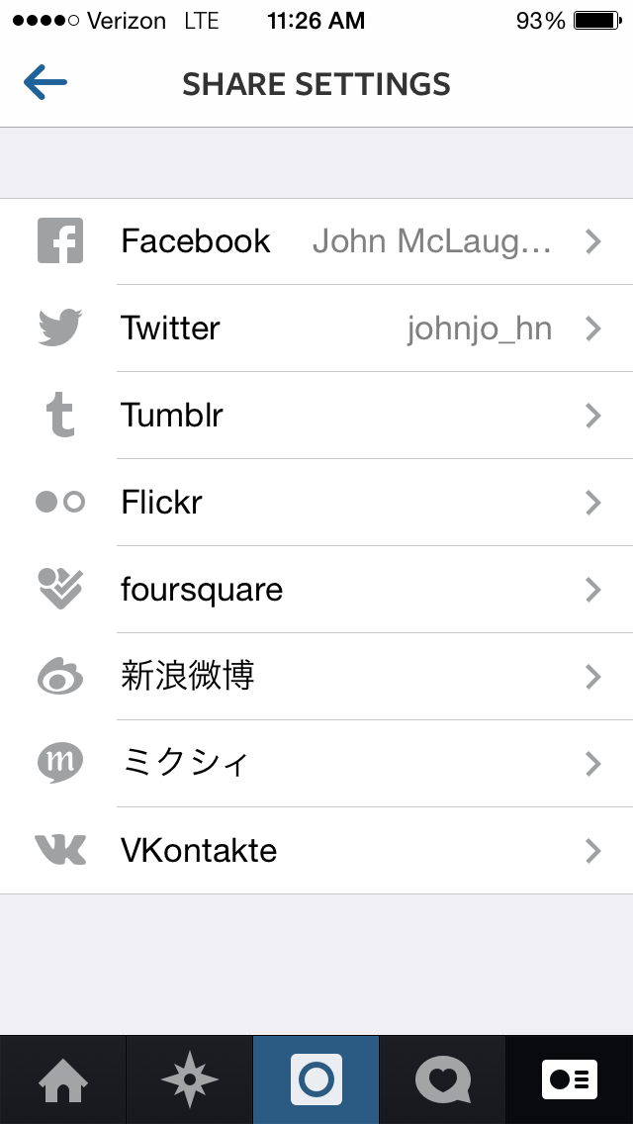
Instagram’s Cross-Posting
Instagram’s Cross-Posting to (Almost) Any Platform
http://thenextweb.com/entrepreneur/2014/05/28/9-iconic-growth-hacks-tech-companies-used-pump-user-base/

Slide 36
Growth Hacker Marketing Steps
Step 1: It begins with product market fit ➔ Make stuff people want.
Step 2: Finding your growth hack
➔ The right customers and the right channels
Step 3: Go viral ➔ Turn 1 into 2 and 2 into 4.
Step 4: Close the loop: Retention and optimization
Step 5: Now….start again
Ryan Holiday, Growth Hacker Marketing
https://dprol.files.wordpress.com/2014/06/growth-hacker-marketing-ryan-holiday.pdf
http://mashable.com/2013/09/02/growth-hacking/
http://torrents4all.net/torrent/9013553/Growth_Hacker_Marketing_-_Ryan_Holiday_[epub_pdf] ??

Slide 37
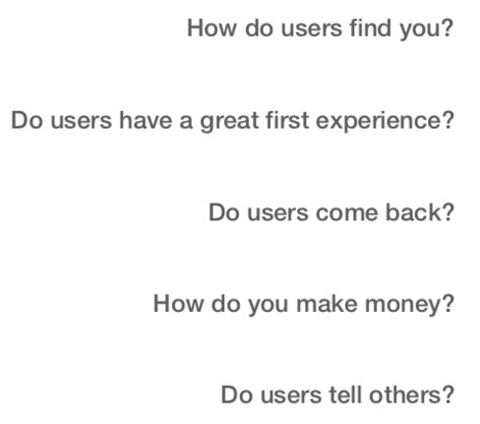
Key Metrics: AARRR Model and Funnel Stage
Acquisition
Activation
Retention
Revenue
Referral
Suspect
Lead
Prospect
Engaged
Customer
Paying
Customer
Reference
(Advocator)
http://500hats.typepad.com/500blogs/2007/09/startup-metrics.html
https://www.youtube.com/watch?v=irjgfW0BIrw
http://www.slideshare.net/dmc500hats/startup-metrics-for-pirates-long-version/
http://free-thinking-cap.blogspot.de/2011/11/aarrr.html

Slide 38
Customer Lifecycle / Conversion Behavior
SEO
Campaigns, Contests
SEM
PR
Biz Dev
Social Networks
Blogs
Affiliates
Apps & Widgets
Direct, Tel, TV
Email
1. ACQUISITION
4. REFERRAL
Domains
Campaigns, Contests
2. Activation
Homepage / Landing Page
Emails & Alerts
Website.com
3. RETENTION
Product Features
Emails & widgets
System Events & Time-based Features
Biz Dev
Blogs, Content
Ads, Lead Gen, Subscriptions, etc
5. Revenue $$$

